Slide 1
The Family Drug and Alcohol Court Sophie Kershaw Tavistock and Portman NHS Foundation Trust Copyright presentation: FDAC Team

Slide 2
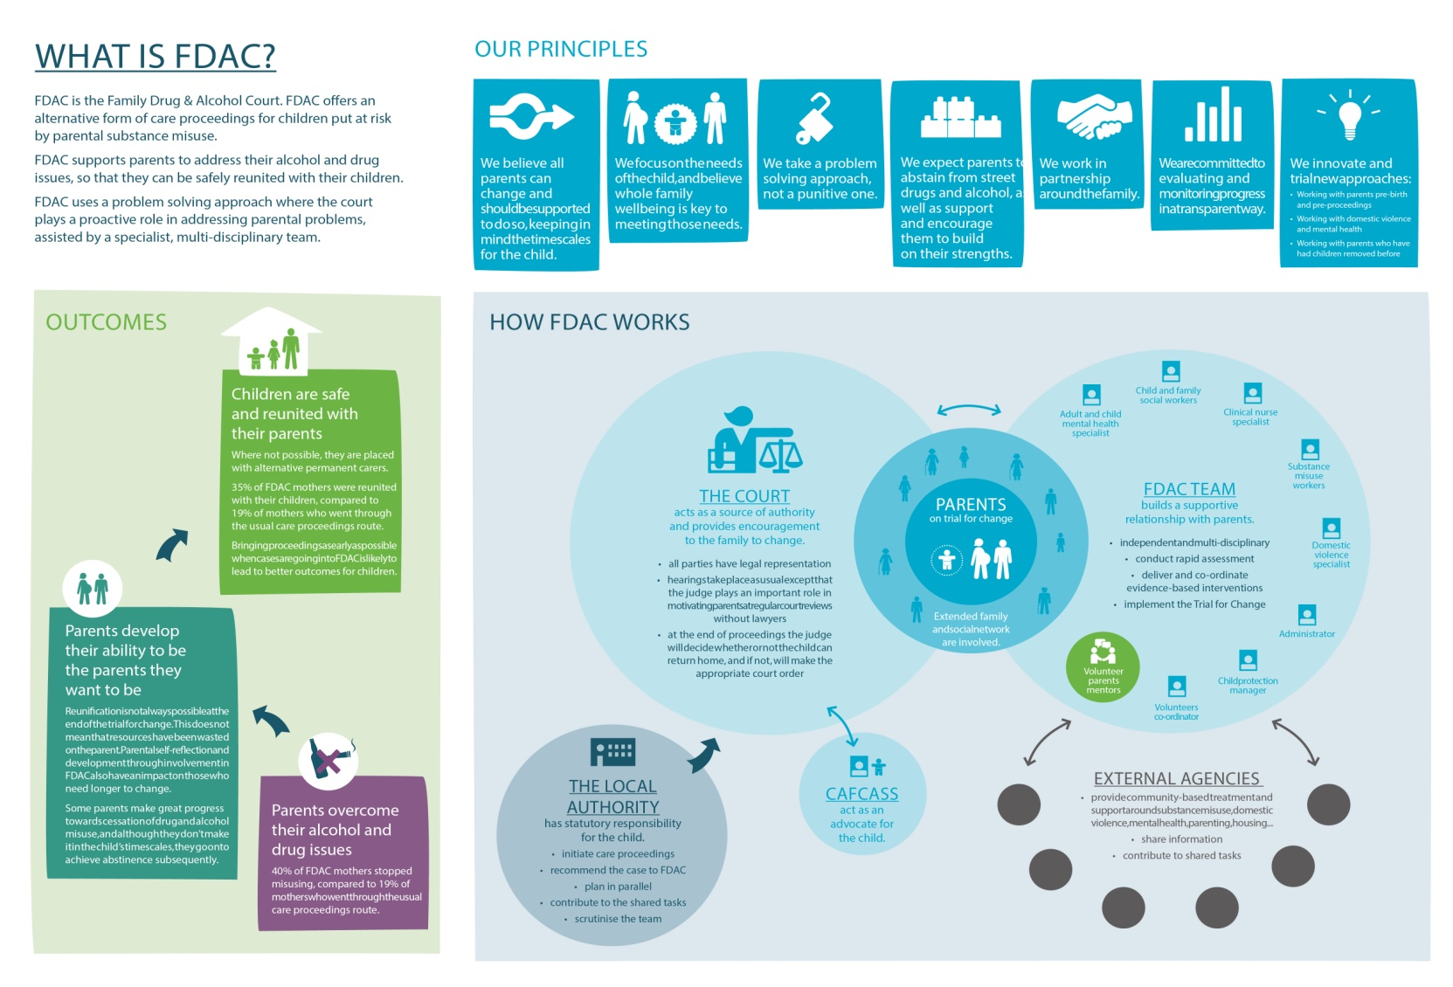

Slide 3
The Family Drug and Alcohol Court
The ‘Family Drug & Alcohol Court’ protects children put at risk by parental substance misuse.
It is an innovative multi-agency intervention involving:
The family court
A specialist multi disciplinary intervention team
Parent Mentors
Social services
Treatment services
Housing
Probation etc

Slide 4
Aims
To improve permanency outcomes for children
To achieve higher rates of control/cessation of substance misuse
To increase the Court’s confidence in decision making without the need
to receive reports from a wide range of external experts
To develop a problem solving approach rather than adversarial

Slide 5
FDAC devises a time limited trial for change with intensive support & compulsion
Trial for Change
Compulsion
Support

Slide 6
C Compulsion – Authority of the court
Two dedicated District Judges
and two others provide back up
Judicial continuity for families
Regular court reviews of the case
without legal representatives
Problem solving approach

Slide 7
Collaboration – Intensive Support for Families
FDAC relies on our network of collaborators
The FDAC team, sit at the centre of a vast network of court, social care, health, housing etc services
We broker, coordinate and
monitor the best possible
intervention package
“Houston we have a problem”

Slide 8
Timescales for the Child
The majority of our cases are new born babies:
The sensitive period for attachment is between 6-18 months.
The decision on whether to return the child has to be taken before the child is 9 months.
This allows permanent placement by the child’s first birthday whether or not they return to their parents.
Other sensitive periods include:
Aged 4-5 years when successful adoption becomes less likely.
Aged 10-12 years after which longterm foster care is more likely to fail.
School transitions.

Slide 9
Trial for Change
Families are given ‘a trial for change’ to test whether parents can overcome their problems and meet their children’s needs in the child’s timeframe.
Families are given the maximum possible support via the FDAC team, Court and other agencies to:
Abstain from street drugs and alcohol,
Begin to address the difficulties driving the substance misuse,
Strengthen their relationships with the children, and
Create a child-centred lifestyle.

Slide 10
Problem solving court approach at all levels

Slide 11
Key Differences
Therapeutic relationships with the FDAC team including the Judge
Goal-based
Swift assessment, testing, referrals and planning via the FDAC Specialist Team
Promotes the family’s problem solving capacities
Collaborative working
FDAC team supports the family and coordinates, reviews and amends the interventions for up to a year
Transparency
Parent Mentors: credible role models of resilience and change
Less adversarial court process
Dedicated district judges
Regular court reviews without legal representatives

Slide 12
FDAC Evaluation
Outcome at the end of Proceedings:
A higher proportion of FDAC parents had stopped misusing by final order
Mothers (40% v 25%)
Fathers (25% v 5%)
A higher proportion of FDAC than comparison mothers both stopped misusing and were reunited with their children (35% v 19%)
If reunification was not possible, placement with alternative permanent carers was not swifter
Involvement in FDAC is an important contributory factor in difference in outcomes

Slide 13
Comparing outcomes of family
reunification: follow-up after one year
Most mothers still living with their children (83% v 78%).
A similar proportion of cases returned to court (13% v 17%)
Levels of support and services were variable post FDAC
Supervision orders – directions rarely used
New episodes of neglect or abuse took place in
proportionately fewer FDAC families (25% v 56%)
Fewer FDAC mothers relapsed (25% v 44%)

Slide 14
Qualitative findings
FDAC operates in a distinctively different way to ordinary care proceedings
Parents & professionals valued the role of the judge, the support of the team, and the hearings without lawyers – and the collaborative approach
Parents felt the process gave them a fair chance

Slide 15
To download full evaluation report and highlights:
www.brunel.ac.uk/fdacresearch
To contact the National FDAC Unit – 0207 278 5708
Skershaw.fdacteam@coram.org.uk

